Slide 1
Exploring the data

Slide 2
DeltaFrequency Band

Slide 3
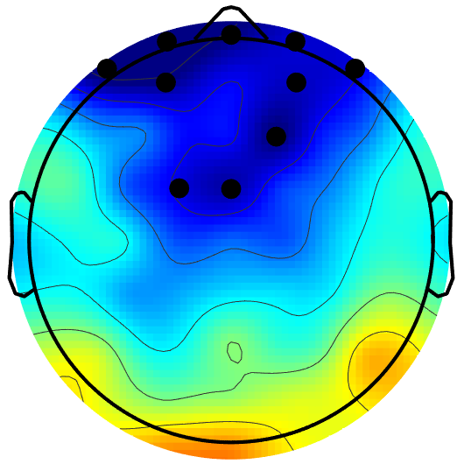

Slide 4
ThetaFrequency Band

Slide 5
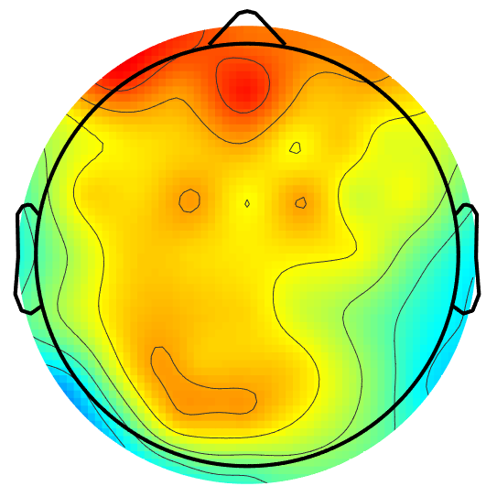

Slide 6
Alpha 1Frequency Band

Slide 7
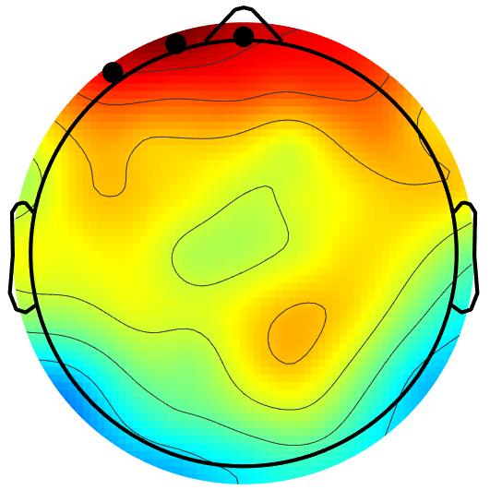

Slide 8
Alpha 2Frequency Band

Slide 9
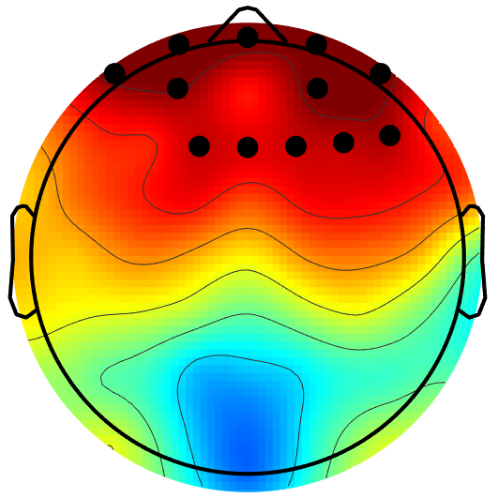

Slide 10
BetaFrequency Band

Slide 11
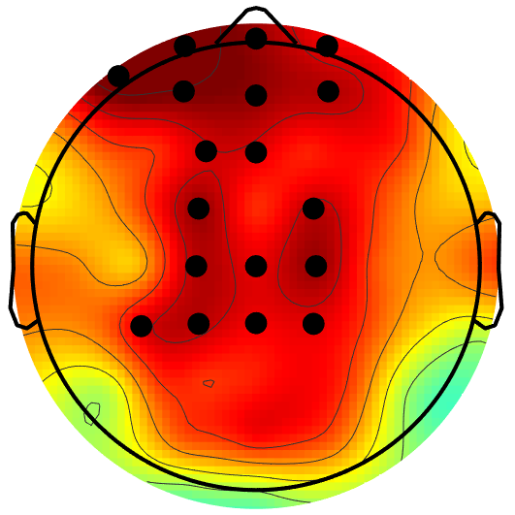

Slide 12
Gamma 1Frequency Band

Slide 13
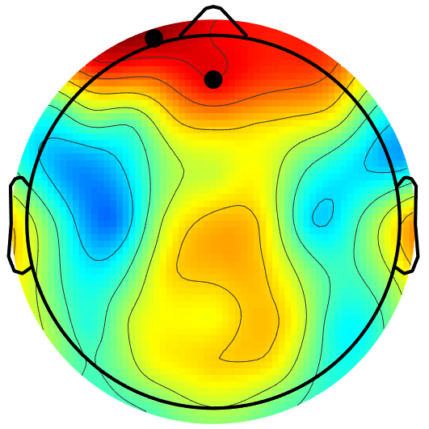

Slide 14
Gamma 2Frequency Band

Slide 15
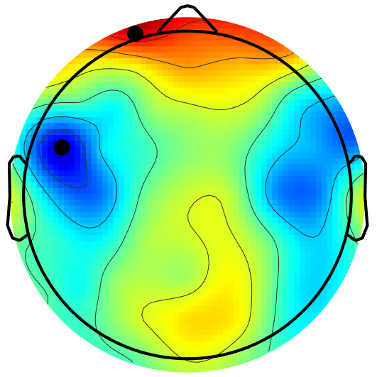

Slide 16
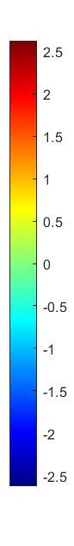
Delta (1-4 Hz)
Theta (4-8 Hz)
Lower Alpha (8-10 Hz)
Upper Alpha (10-12 Hz)
t values
Beta (12-30 Hz)
Lower Gamma (30-45 Hz)
Upper Gamma (45 - 70Hz)

Slide 17
Delta (1-4 Hz)
Theta (4-8 Hz)
Lower Alpha (8-10 Hz)
Upper Alpha (10-12 Hz)
t values
Beta (12-30 Hz)
Lower Gamma (30-45 Hz)
Upper Gamma (45 - 70Hz)

Slide 18
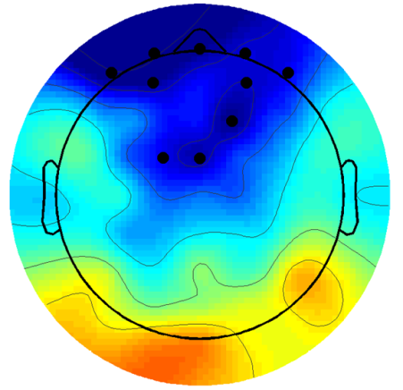
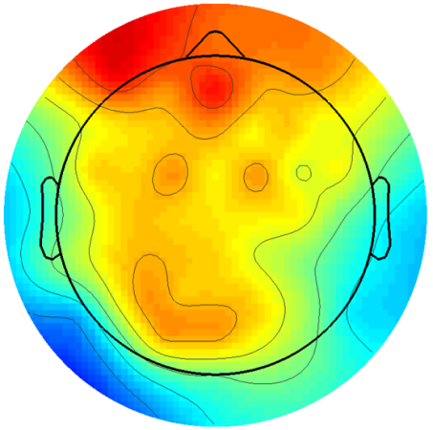
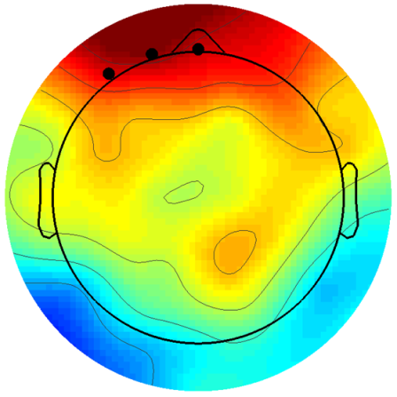
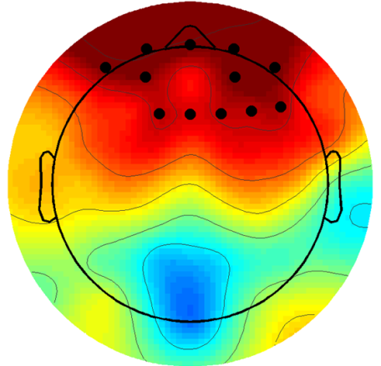

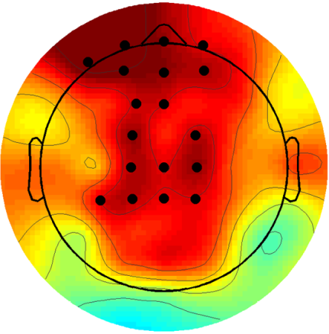
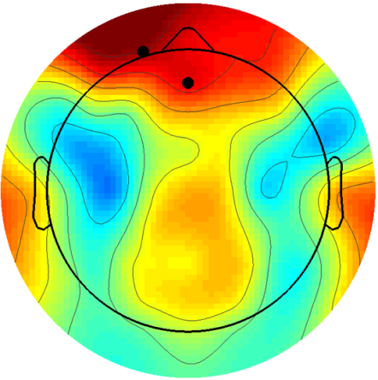
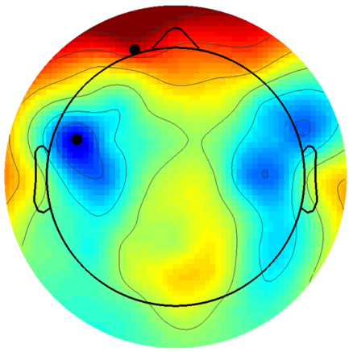
Higher alpha power in flow (attention and cognitive control)
Delta (1-4 Hz)
Theta (4-8 Hz)
Lower Alpha (8-10 Hz)
Upper Alpha (10-12 Hz)
t values
Beta (12-30 Hz)
Lower Gamma (30-45 Hz)
Upper Gamma (45 - 70Hz)
Topoplots of t-values by comparing EEG power of seven frequency bands between flow and non-flow states. Red indicates that power is higher in the flow condition while blue indicates that the power is higher in non-flow condition. Statistically significant electrodes (p < .05) are indicated by black dots.

Slide 19
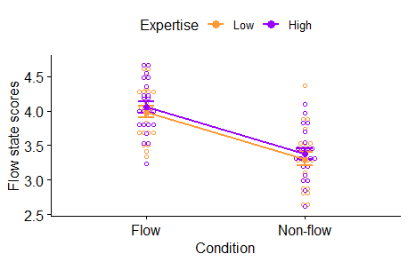
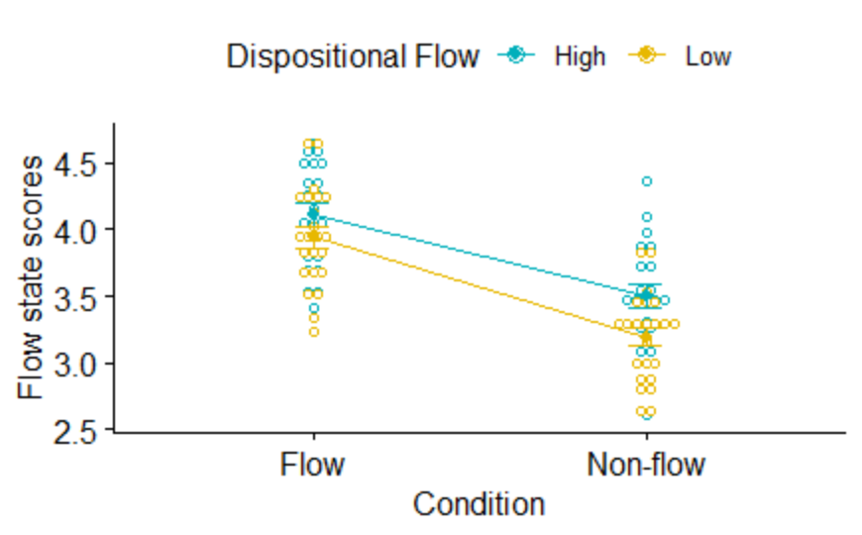
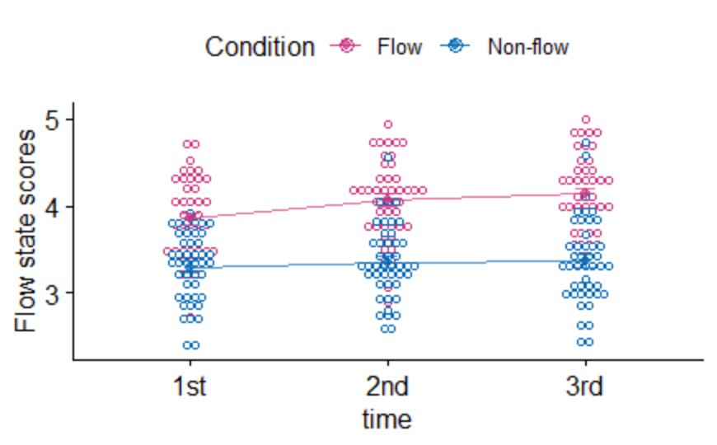

Slide 20
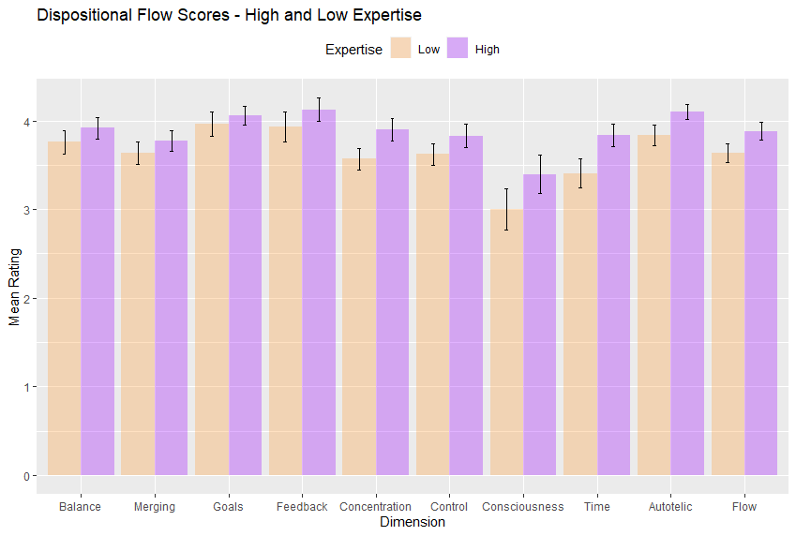
A
B

Slide 21
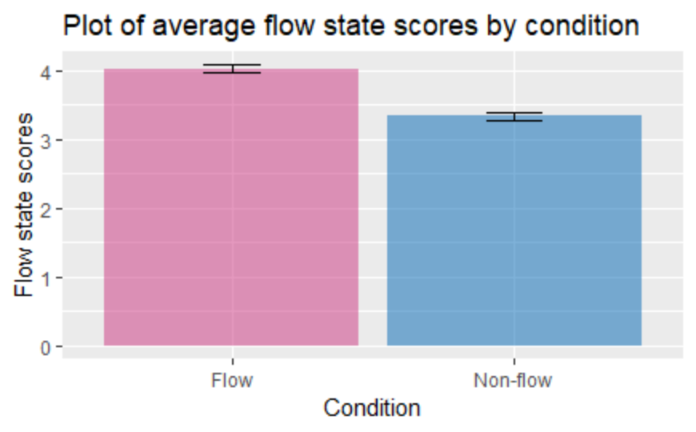

Slide 22



Notes:
Upper alpha cluster, p = 0.0359, clusterstat = 30.465, stddev = 0.0083, cirange = 0.0163
Beta cluster p = 0.01, clusterstat = 42.5721, stddev = 0.0044, cirange = 0.0087

Slide 23
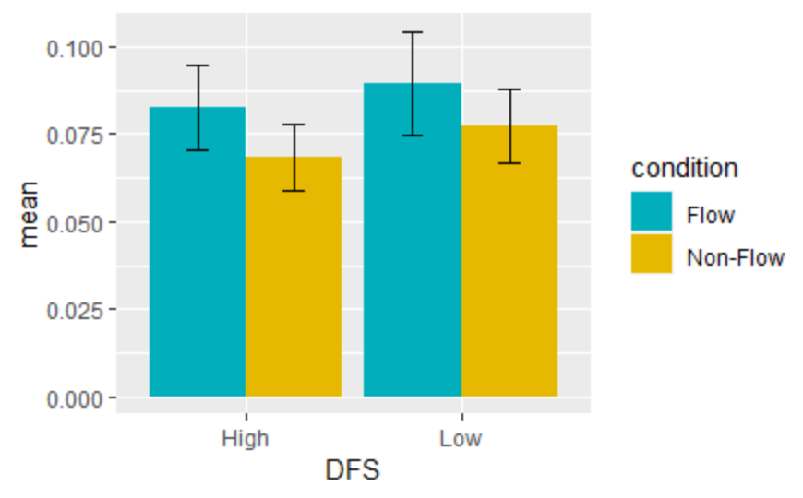
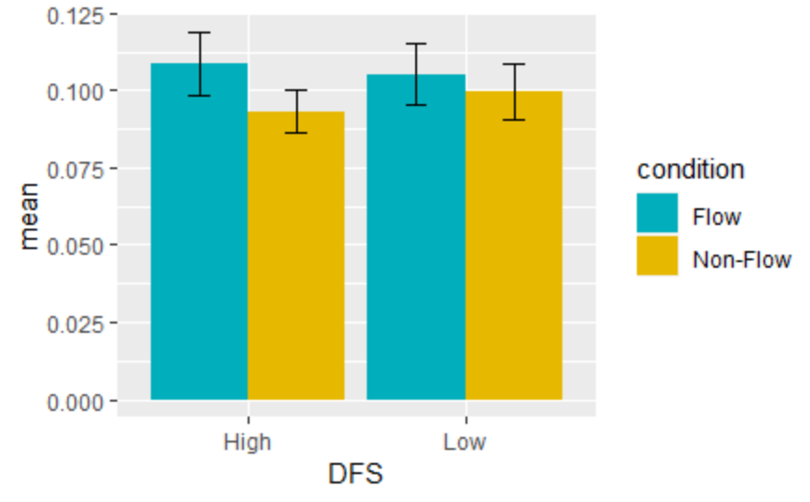
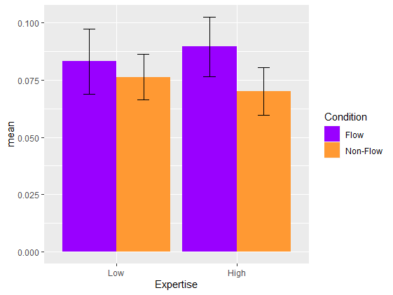
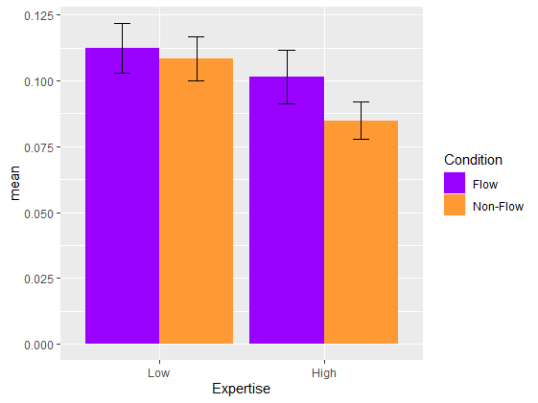
A
B
Upper Alpha (10-12 Hz)
D
Beta (12-30 Hz)
C
E
F
Notes:
Upper alpha cluster, p = 0.0359, clusterstat = 30.465, stddev = 0.0083, cirange = 0.0163
Beta cluster p = 0.01, clusterstat = 42.5721, stddev = 0.0044, cirange = 0.0087
Alpha cluster t-test t(43) = 2.7266, p = 0.009224
Beta cluster t-test t(43) = 2.8037, p = 0.007551
After correcting for multiple comparisons, none of them correlate with flow and its dimensions except alpha and time perception. The larger the difference between flow and non-flow, the larger the difference between time perception across conditions

Slide 24
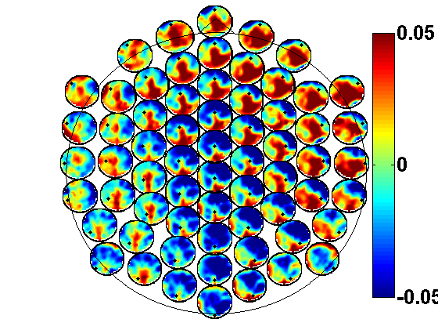
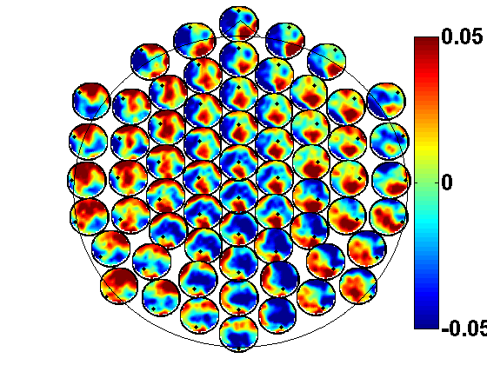
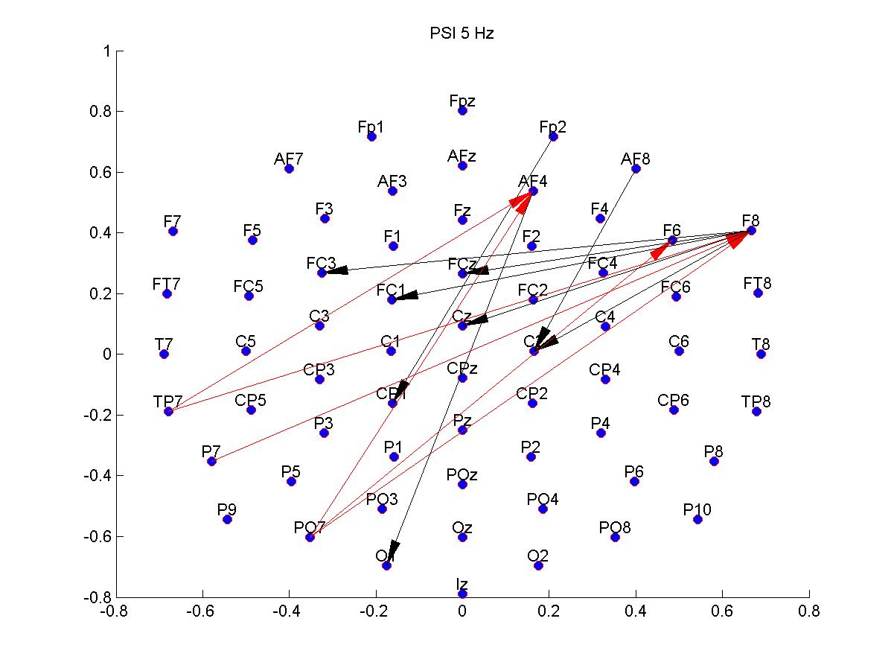
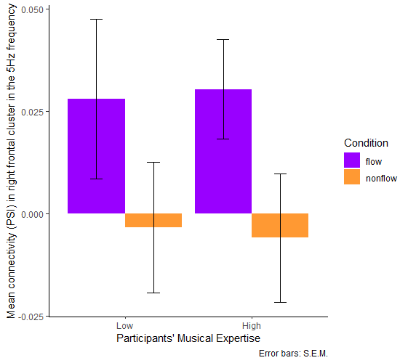
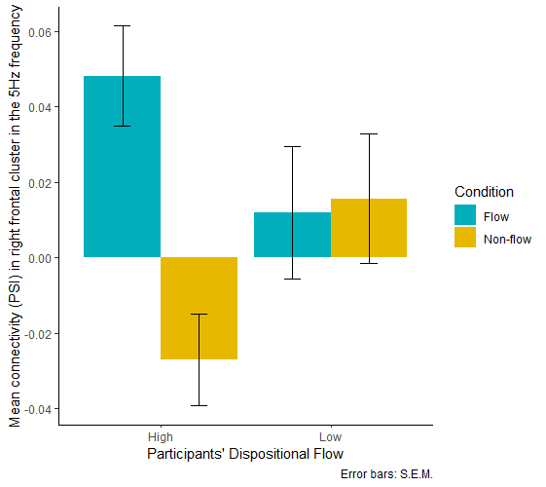
A
B
C
Flow state
Non-flow state
D
E

Slide 25
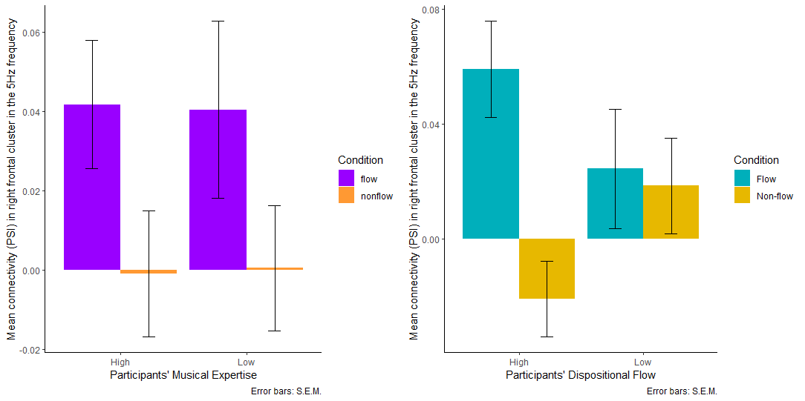
A
B
C
Flow state
Non-flow state
D
E

Slide 26
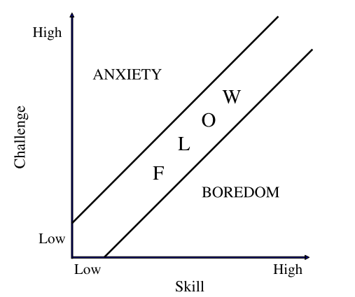
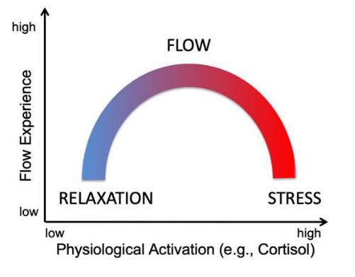
Task difficulty

